Slide 1
Operating system services

Slide 2
Operating System Services Following are the five services provided by operating systems to the convenience of the users
1. Program Execution :The purpose of computer systems is to allow the user to execute programs. So the operating system provides an environment where the user can conveniently run programs. Running a program involves the allocating and deallocating memory, CPU scheduling in case of multiprocessing.
2. I/O Operations :Each program requires an input and produces output. This involves the use of I/O. So the operating systems are providing I/O makes it convenient for the users to run programs.
3. File System Manipulation :The output of a program may need to be written into new files or input taken from some files. The operating system provides this service.
4. Communications :The processes need to communicate with each other to exchange information during execution. It may be between processes running on the same computer or running on the different computers. Communications can be occur in two ways: (i) shared memory or (ii) message passing

Slide 3
File Management :A file is a collection of related information defined by its creator. Commonly, files represent programs (both source and object forms) and data.
The operating system is responsible for the following activities in connections with file management:
✦ File creation and deletion. ✦ Directory creation and deletion. ✦ Support of primitives for manipulating files and directories. ✦ Mapping files onto secondary storage. ✦ File backup on stable (nonvolatile) storage media. I/O System Management
The I/O system consists of: ✦ A buffer-caching system ✦ A general device-driver interface ✦ Drivers for specific hardware devices Secondary-Storage Management Since main memory (primary storage) is volatile and too small to accommodate all data and programs permanently, the computer system must provide secondary storage to back up main memory. Most modern computer systems use disks as the principle on-line storage medium, for both programs and data. The operating system is responsible for the following activities in connection with disk management:
✦ Free space management ✦ Storage allocation ✦ Disk scheduling

Slide 4
Networking (Distributed Systems)
♦ A distributed system is a collection processors that do not share memory or a clock. Each processor has its own local memory.
♦ The processors in the system are connected through a communication network. ♦ Communication takes place using a protocol. ♦ A distributed system provides user access to various system resources. ♦ Access to a shared resource allows: ✦ Computation speed-up

Slide 5
Increased data availability ✦ Enhanced reliability Protection System ♦ Protection refers to a mechanism for controlling access by programs, processes, or users to both system and user resources.
♦ The protection mechanism must:
✦ distinguish between authorized and unauthorized usage. ✦ specify the controls to be imposed.
✦ provide a means of enforcement. Command-Interpreter System • Many commands are given to the operating system by control statements which deal with:
✦ process creation and management
✦ I/O handling ✦ secondary-storage management ✦ main-memory management ✦ file-system access ✦ protection ✦ networking • The program that reads and interprets control statements is called variously: ✦ command-line interpreter ✦ shell (in UNIX) • Its function is to get and execute the next command statement.

Slide 6
Operating-System Structures • System Components • Operating System Services • System Calls • System Programs • System Structure • Virtual Machines • System Design and Implementation • System Generation

Slide 7
Common System Components • Process Management • Main Memory Management • File Management • I/O System Management • Secondary Management • Networking • Protection System • Command-Interpreter System

Slide 8
5. Error Detection An error is one part of the system may cause malfunctioning of the complete system. To avoid such a situation operating system constantly monitors the system for detecting the errors.
This relieves the user of the worry of errors propagating to various part of the system and causing malfunctioning. Following are the three services provided by operating systems for ensuring the efficient operation of the system itself.
1. Resource allocation When multiple users are logged on the system or multiple jobs are running at the same time, resources must be allocated to each of them. Many different types of resources are managed by the operating system.
2. Accounting The operating systems keep track of which users use how many and which kinds of computer resources. This record keeping may be used for accounting (so that users can be billed) or simply for accumulating usage statistics. 3. Protection When several disjointed processes execute concurrently, it should not be possible for one process to interfere with the others, or with the operating system itself.
Protection involves ensuring that all access to system resources is controlled. Security of the system from outsiders is also important. Such security starts with each user having to authenticate him to the system, usually by means of a password, to be allowed access to the resources.

Slide 9
Functions of Operating System: Process Management A process is a program in execution. A process needs certain resources, including CPU time, memory, files, and I/O devices, to accomplish its task.
The operating system is responsible for the following activities in connection with process management. ✦ Process creation and deletion. ✦ process suspension and resumption. ✦ Provision of mechanisms for: • process synchronization • process communication Main-Memory Management Memory is a large array of words or bytes, each with its own address. It is a repository of quickly accessible data shared by the CPU and I/O devices. Main memory is a volatile storage device. It loses its contents in the case of system failure.
The operating system is responsible for the following activities in connections with memory management: ♦ Keep track of which parts of memory are currently being used and by whom. ♦ Decide which processes to load when memory space becomes available. ♦ Allocate and de-allocate memory space as needed.

Slide 10
Functions of Operating System: Process Management A process is a program in execution. A process needs certain resources, including CPU time, memory, files, and I/O devices, to accomplish its task. The operating system is responsible for the following activities in connection with process management. ✦ Process creation and deletion. ✦ process suspension and resumption.
✦ Provision of mechanisms for: • process synchronization • process communication Main-Memory Management Memory is a large array of words or bytes, each with its own address. It is a repository of quickly accessible data shared by the CPU and I/O devices. Main memory is a volatile storage device. It loses its contents in the case of system failure.
The operating system is responsible for the following activities in connections with memory management: ♦ Keep track of which parts of memory are currently being used and by whom. ♦ Decide which processes to load when memory space becomes available. ♦ Allocate and de-allocate memory space as needed.

Slide 11
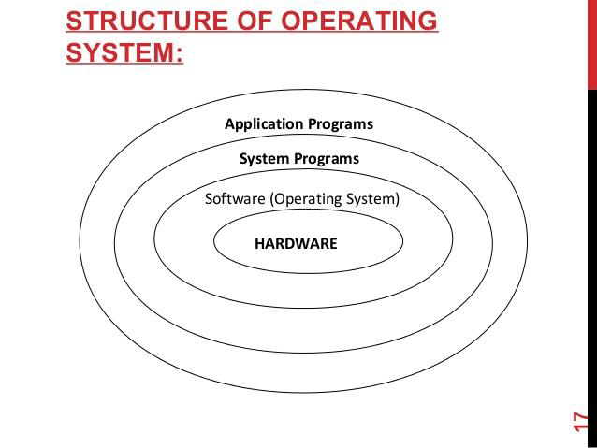

Slide 12
Operating System Design and Implementation
Design and Implementation of OS not “solvable”, but some approaches have proven successful Internal structure of different Operating Systems can vary widely
Start by defining goals and specifications Affected by choice of hardware, type of system User goals and System goals
User goals – operating system should be convenient to use, easy to learn, reliable, safe, and fast
System goals – operating system should be easy to design, implement, and maintain, as well as flexible, reliable, error-free, and efficient
Important principle to separate
Policy: What will be done?
Mechanism: How to do it?
Mechanisms determine how to do something, policies decide what will be done
The separation of policy from mechanism is a very important principle, it allows maximum flexibility if policy decisions are to be changed later

Slide 13
Simple Structure
MS-DOS – written to provide the most functionality in the least space Not divided into modules
Although MS-DOS has some structure, its interfaces and levels of Functionality are not well separated

Slide 14
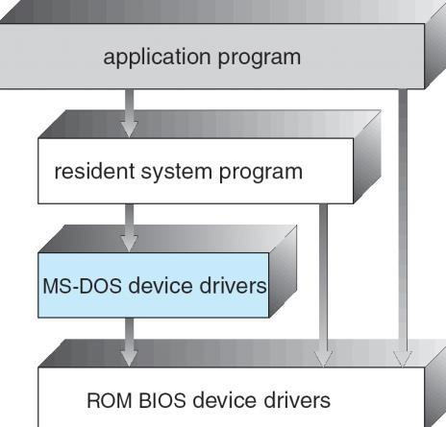
The operating system is divided into a number of layers (levels), each built on top of lower layers. The bottom layer (layer 0), is the hardware; the highest (layer N) is the user interface.
With modularity, layers are selected such that each uses functions (operations) and services of only lower-level layers

Slide 15
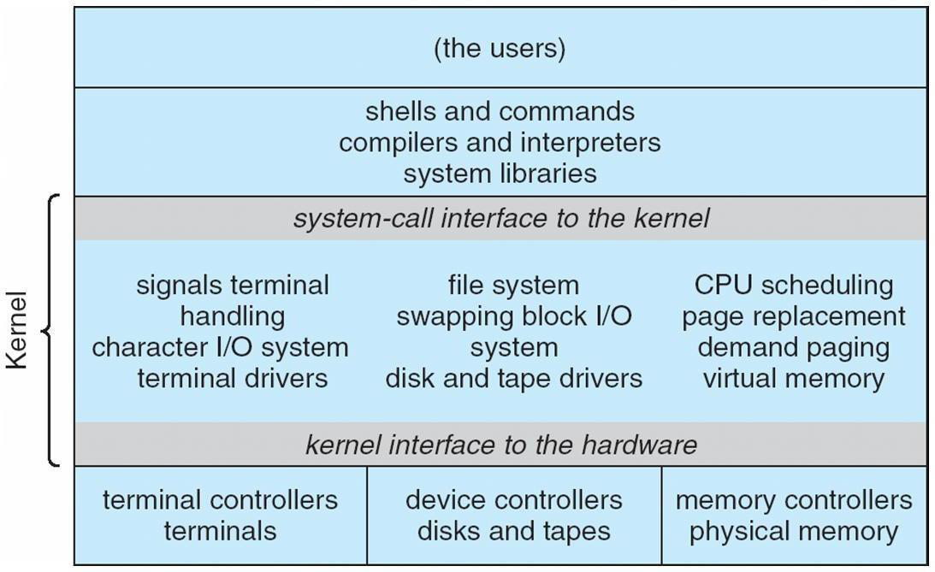
Traditional UNIX System Structure

Slide 16
UNIX
UNIX – limited by hardware functionality, the original UNIX operating system had limited structuring.
The UNIX OS consists of two separable parts
Systems programs The kernel
Consists of everything below the system-call interface and above the physical hardware Provides the file system, CPU scheduling, memory management, and other operating-system

Slide 17
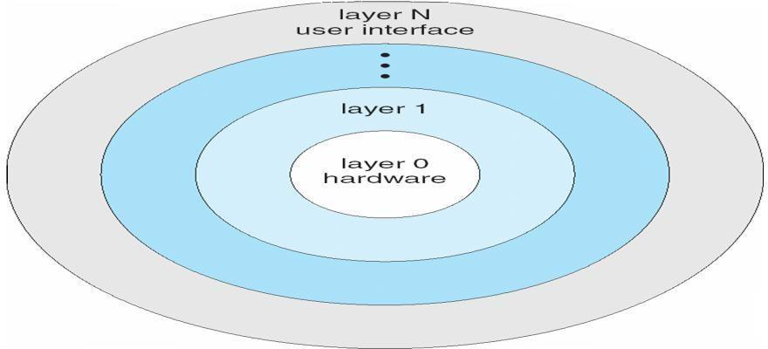
functions; a large number of functions for one level
Layered Operating System

Slide 18
Micro kernel System Structure
Moves as much from the kernel into “user” space
Communication takes place between user modules using message passing Benefits:
Easier to extend a microkernel
Easier to port the operating system to new architectures More reliable (less code is running in kernel mode)
More secure Detriments:
Performance overhead of user space to kernel space communication

Slide 19
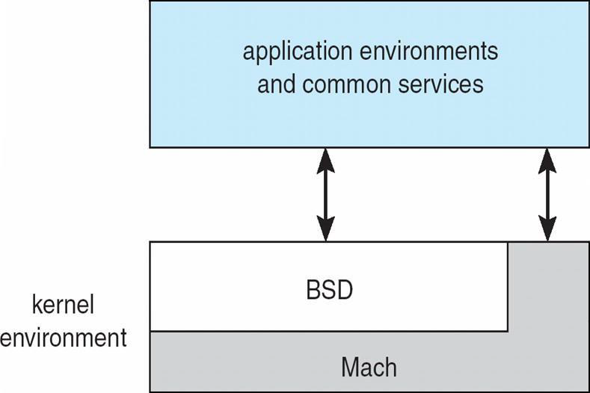
Mac OS X Structure

Slide 20
Modules
Most modern operating systems implement kernel modules Uses object-oriented approach
Each core component is separate
Each talks to the others over known interfaces Each is loadable as needed within the kernel Overall, similar to layers but with more flexible

Slide 21
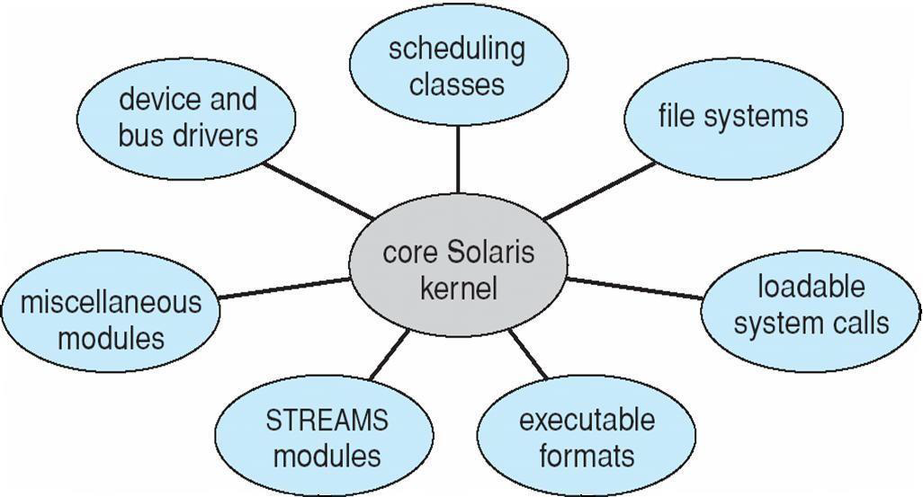
Solaris Modular Approach

Slide 22
Virtual Machines
A virtual machine takes the layered approach to its logical conclusion. It treats hardware and the operating system kernel as though they were all hardware
A virtual machine provides an interface identical to the underlying bare hardware
The operating system host creates the illusion that a process has its own processor and (virtual memory) Each guest provided with a (virtual) copy of underlying computer
Virtual Machines History and Benefits
First appeared commercially in IBM mainframes in 1972
Fundamentally, multiple execution environments (different operating systems) can share the same hardware
Protect from each other
Some sharing of file can be permitted, controlled
Commutate with each other, other physical systems via networking Useful for development, testing
Consolidation of many low-resource use systems onto fewer busier systems
“Open Virtual Machine Format”, standard format of virtual machines, allows a VM to run within many different virtual machine (host) platforms

Slide 23
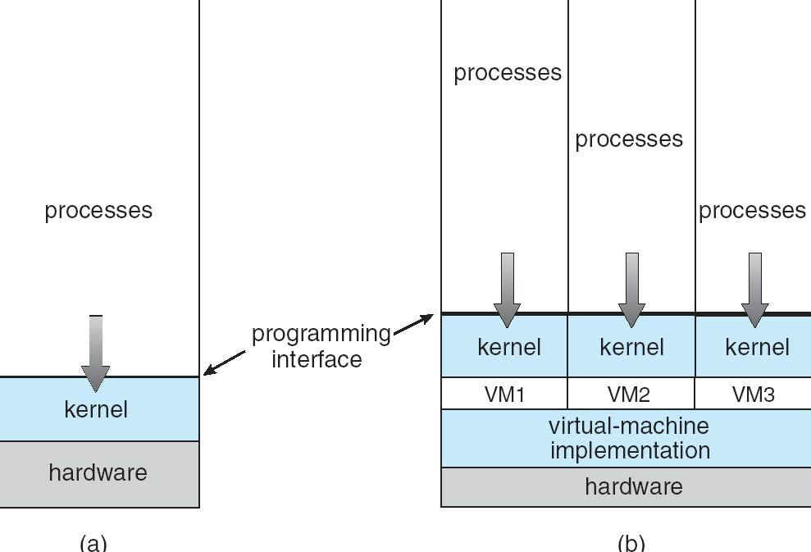

Slide 24
Para-virtualization
Presents guest with system similar but not identical to hardware Guest must be modified to run on par virtualized hardware
Guest can be an OS, or in the case of Solaris 10 applications running in containers Solaris 10 with Two Containers

Slide 25
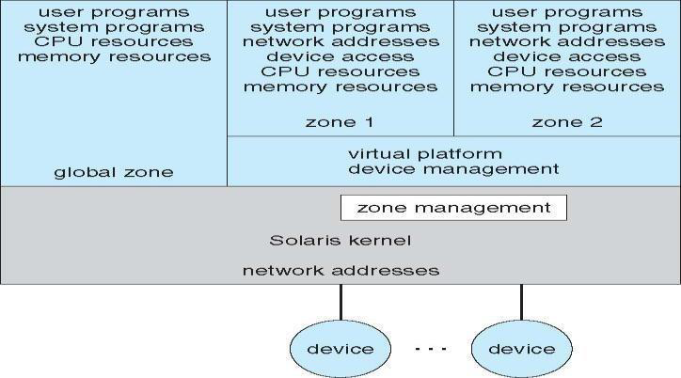

Slide 26
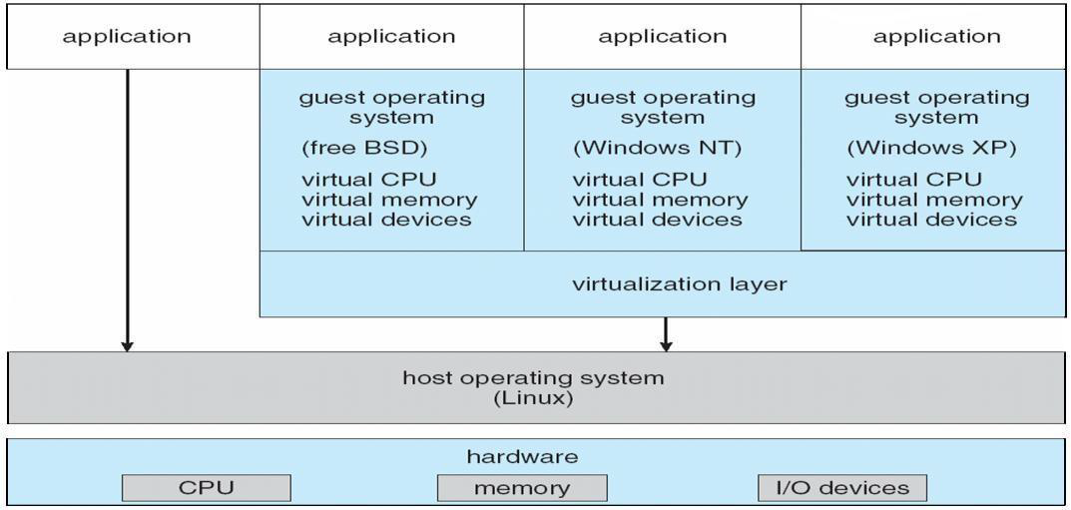
VMware Architecture

Slide 27
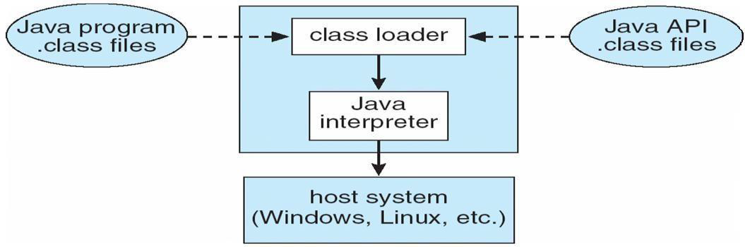
The Java Virtual Machine

Slide 28
Process
A process is a program at the time of execution.
Differences between Process and Program

Slide 29
Process States
When a process executed, it changes the state, generally the state of process is determined by the current activity of the process. Each process may be in one of the following states:
1. New : The process is beingcreated.
2. Running : The process is beingexecuted.
3. Waiting : The process is waiting for some event tooccur.
4. Ready : The process is waiting to be assigned to a processor.
5. Terminated : The Process has finishedexecution.
Only one process can be running in any processor at any time, But many process may be in ready and waiting states. The ready processes are loaded into a “ready queue”.

Slide 30
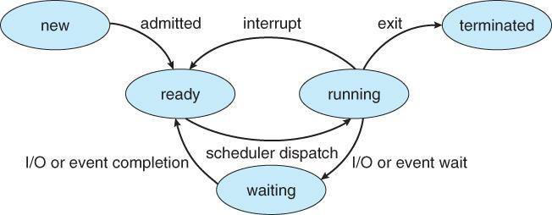
Only one process can be running in any processor at any time, But many process may be in ready and waiting states. The ready processes are loaded into a “ready queue”.
Diagram of process state

Slide 31
a) New ->Ready : OS creates process and prepares the process to be executed,thenOSmoved the process into ready queue.
b) Ready->Running : OS selects one of the Jobs from ready Queue and move themfrom ready to Running.
c) Running->Terminated : When the Execution of a process has Completed, OSterminatesthatprocess from running state. Sometimes OS terminates the process for someother reasons including Time exceeded, memory unavailable, access violation, protection Error, I/O failure and soon.
d) Running->Ready : When the time slot of the processor expired (or) If the
Processor received anyi nterrupt signal, the OS shifted Running -> ReadyState.
e) Running -> Waiting : A process is put into the waiting state, if the process need an event occur (or) an I/O Device require.
f) Waiting->Ready : A process in the waiting state is moved to ready state when the event for whichit has been Completed.

Slide 32
Threads:
A process is divide into number of light weight process, each light weight process is said to be a Thread. The Thread has a program counter (Keeps track of which instruction to execute next), registers (holds its current working variables), stack (execution History).
Thread States:
1. bornState : A thread is justcreated.
2. readystate : The thread is waiting forCPU.
3. running : System assigns the processor to thethread.
4. sleep : A sleeping thread becomes ready after the designated sleep timeexpires.
5. dead : The Execution of the threadfinished

Slide 33
Eg: Word processor.
Typing, Formatting, Spell check, saving are threads
Multithreading
A process is divided into number of smaller tasks each task is called a Thread. Number of Threads with in a Process execute at a time is called Multithreading.
If a program, is multithreaded, even when some portion of it is blocked, the whole program is not blocked.The rest of the program continues working If multiple CPU’s are available.
Multithreading gives best performance.If we have only a single thread, number of CPU’s available, No performance benefits achieved.
• Process creation is heavy-weight while thread creation is light-weight
Can simplify code, increase efficiency

Slide 34
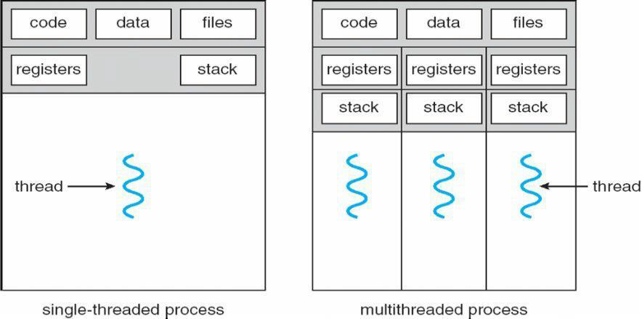

Slide 35
Kernels are generally multithreaded
CODE- Contains instruction
DATA- holds global variable FILES- opening and closing files
REGISTER- contain information about CPU state
STACK-parameters, local variables, functions
Types Of Threads:
1) User Threads : Thread creation, scheduling, management happen in user space by Thread Library. user threads are faster to create and manage. If a user thread performs a system call, which blocks it, all the other threads in that process one also automatically blocked, whole process is blocked.
Advantages
• Thread switching does not require Kernel mode privileges.
• User level thread can run on any operating system.
• Scheduling can be application specific in the user level thread.
• User level threads are fast to create and managed

Slide 36
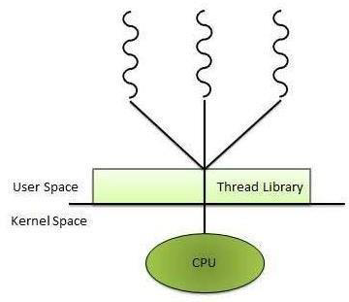
Disadvantages
• In a typical operating system, most system calls areblocking.
• Multithreaded application cannot take advantage ofmultiprocessing.
2) Kernel Threads: kernel creates, schedules, manages these threads .these threads are slower, manage. If one thread in a process blocked, over all process need not be blocked.
Advantages
• Kernel can simultaneously schedule multiple threads from the same process on multiple processes.
• If one thread in a process is blocked, the Kernel can schedule another thread of the same process.
• Kernel routines themselves can multithreaded.
Disadvantages
• Kernel threads are generally slower to create and manage than the userthreads.
• Transfer of control from one thread to another within same process requires a mode switch to the Kernel.

Slide 37
Many to many relationship.
• Many to one relationship.
• One to one relationship.
Many to Many Model
In this model, many user level threads multiplexes to the Kernel thread of smaller or equal numbers. The number of Kernel threads may be specific to either a particular application or a particular machine.
Following diagram shows the many to many model. In this model, developers can create as many user threads as necessary and the corresponding Kernel threads can run in parallels on a multiprocessor.

Slide 38
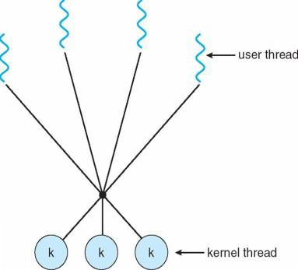

Slide 39
Many to One Model
Many to one model maps many user level threads to one Kernel level thread. Thread management is done in user space. When thread makes a blocking system call, the entire process will be blocks. Only one thread can access the Kernel at a time,so multiple threads are unable to run in parallel on multiprocessors.
If the user level thread libraries are implemented in the operating system in such a way that system does not support them then Kernel threads use the many to one relationship modes.

Slide 40
One to One Model
There is one to one relationship of user level thread to the kernel level thread.This model provides more concurrency than the many to one model. It also another thread to run when a thread makes a blocking system call. It support multiple thread to execute in parallel on microprocessors.
Disadvantage of this model is that creating user thread requires the corresponding Kernel thread. OS/2, windows NT and windows 2000 use one to one relationship model.

Slide 41
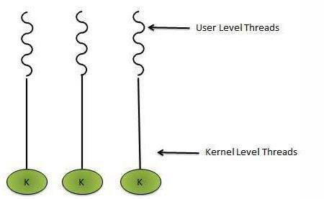

Slide 42
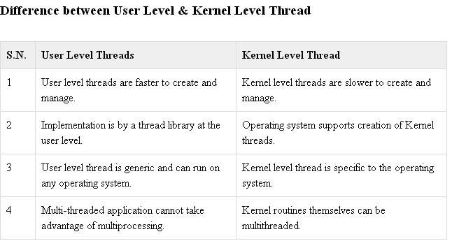

Slide 43
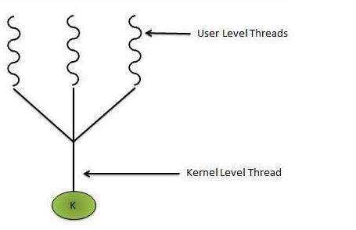

Slide 44
Multithreading Models
Some operating system provides a combined user level thread and Kernel level thread facility. Solaris is a good example of this combined approach. In a combined system, multiple threads within the same application can run in parallel on multiple processors and a blocking system call need not block the entire process. Multithreading models are three types

